Slide 1
Savour the sea

Slide 2
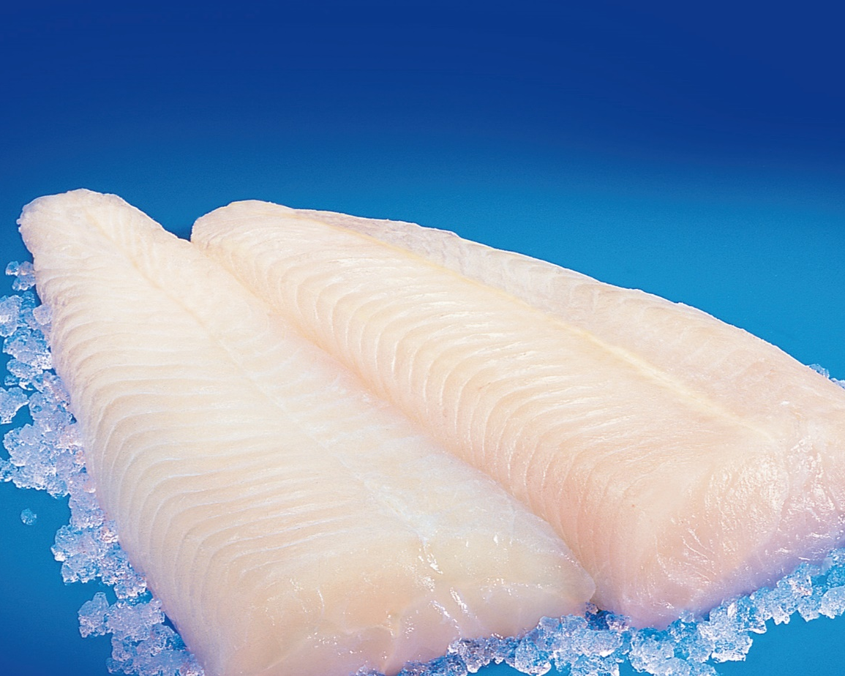
Fillets - Skinless & Skin-On
SKIN-ON FILLETS
SKINLESS FILLETS

Slide 3
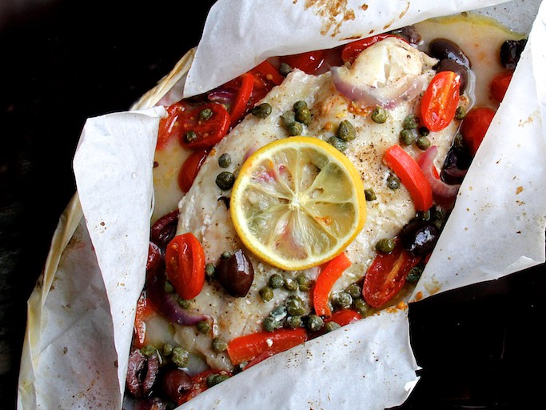
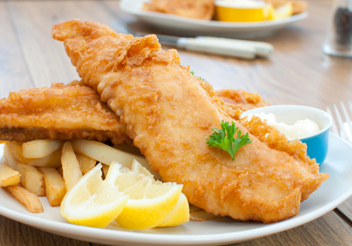
Fillets - Skinless & Skin-On
BATTERED FILLETS
EN PAPILLOTE FILLETS

Slide 4
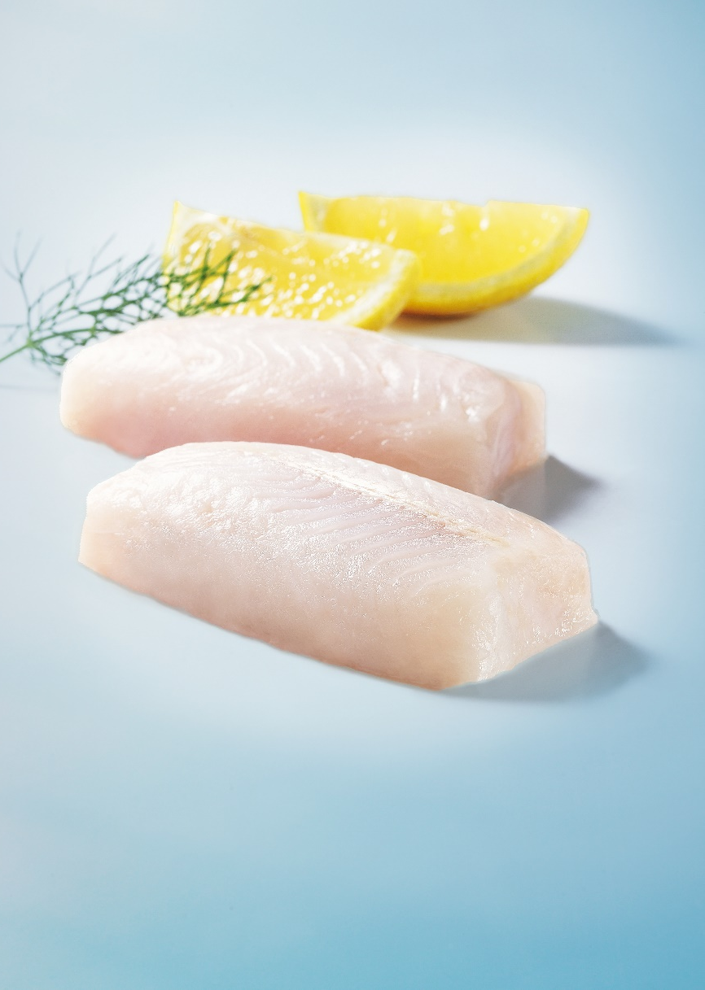
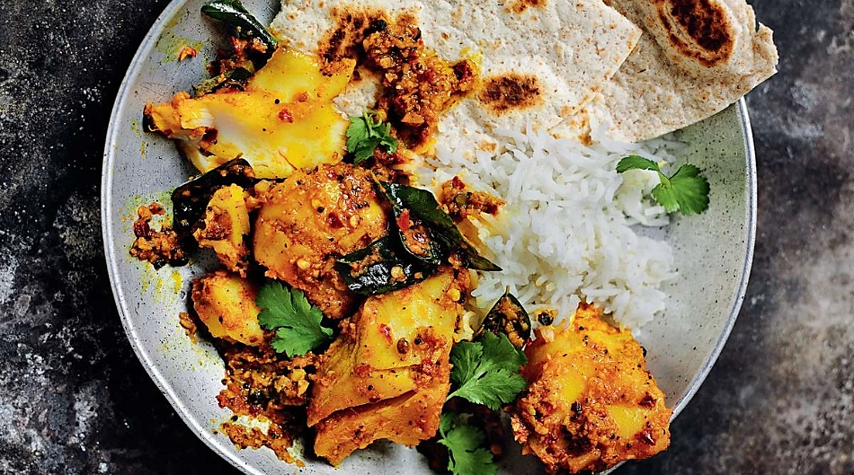
IQF Portions - 120g / 70g
CRUMBED IQF PORTIONS
GLAZED IQF PORTIONS
IQF PORTIONS
CURRIED IQF PORTIONS
BUTTER IQF PORTIONS

Slide 5
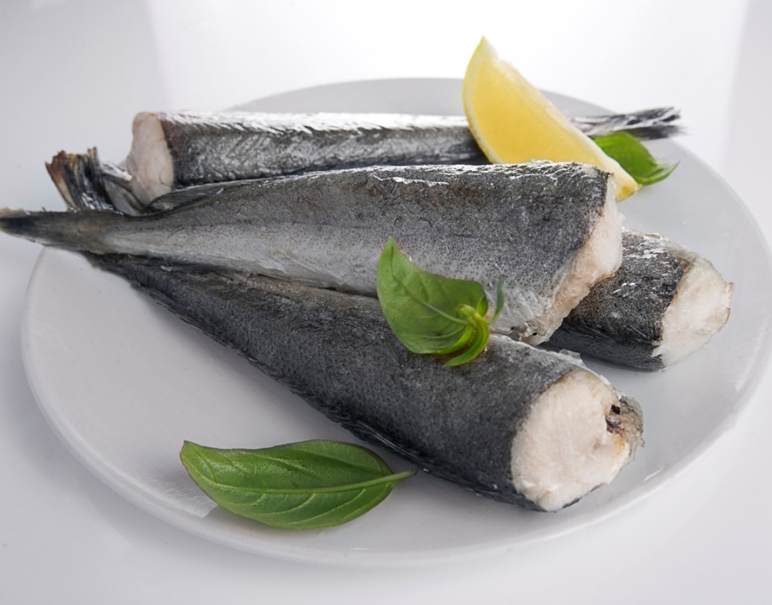
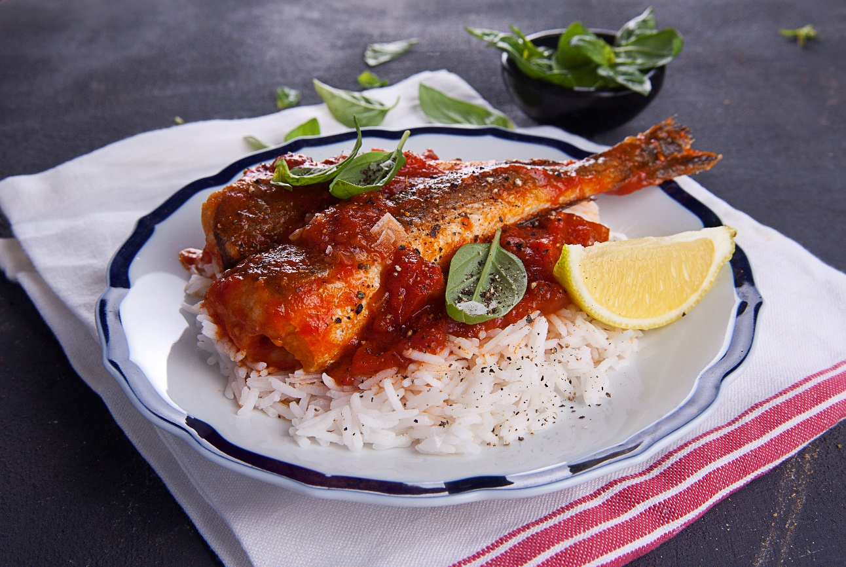
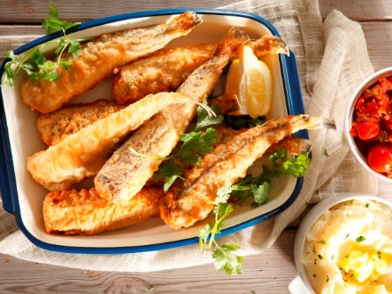
Baby Hake
BABY HAKE
SAUCY BABY HAKE
CRISPY TEMPURA BABY HAKE

Slide 6
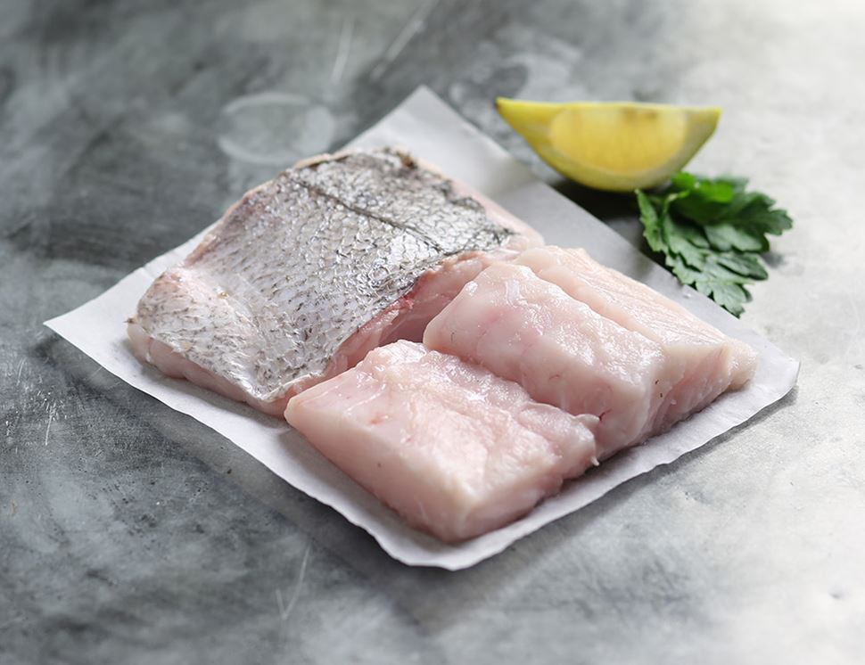
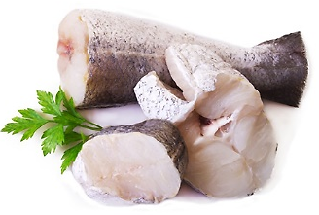
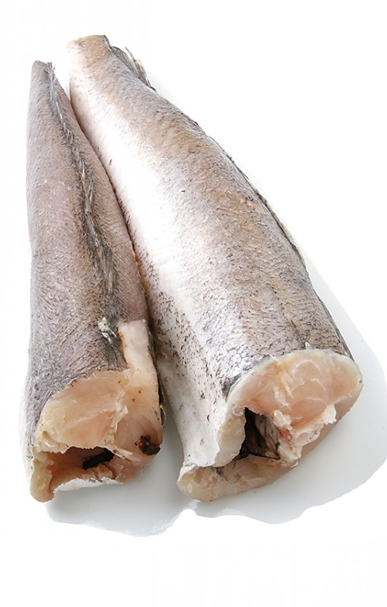
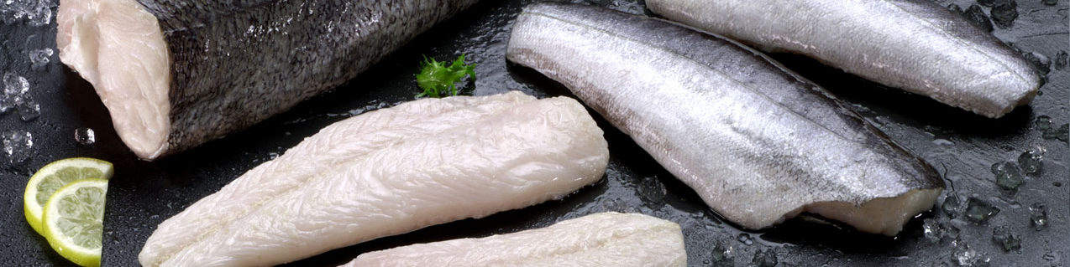
HGT Hake
STEAKS - HGT HAKE
CUTLETS - HGT HAKE
HGT HAKE
FILLETS - HGT HAKE

Slide 7
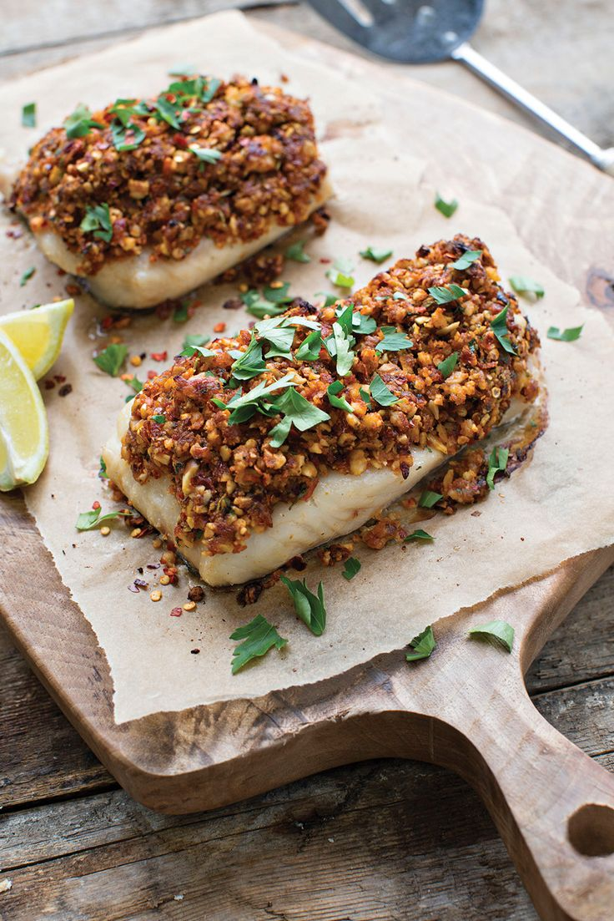
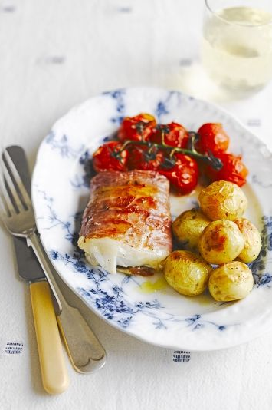
IQF Loins
IQF LOINS
COATED IQF LOINS
WRAPPED IQF LOINS

